Slide 1

Request for KSPQP changes for Version 8.0 May 2025
Paul Smith

Slide 2
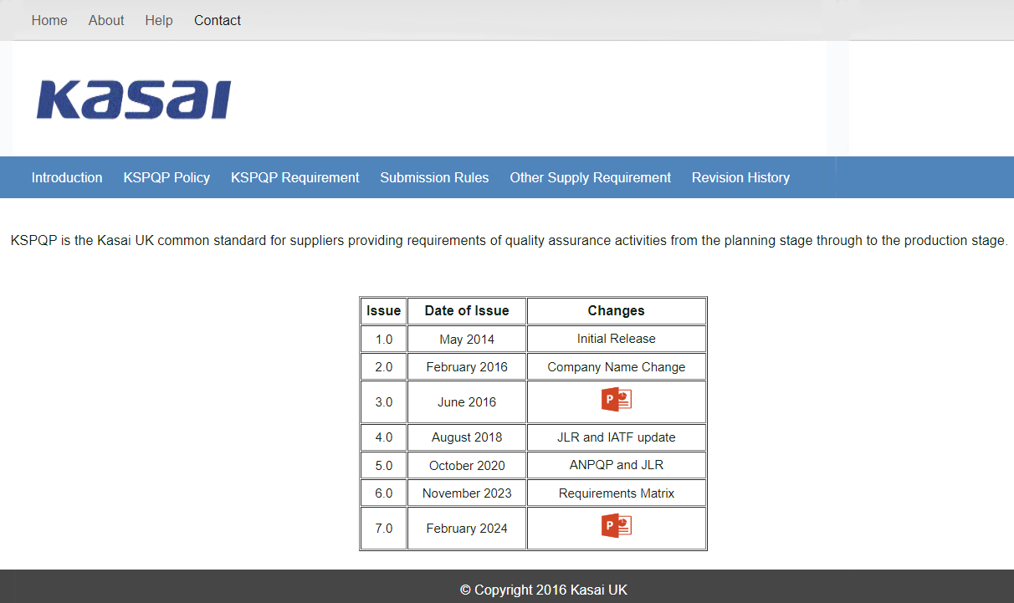
Version 8 changes
Add row Issue
Version 8.0,
Date of Issue
May 2025
Click Icon to access change information

Slide 3
Version 8 Changes
DOCUMENT COMPLETION INSTRUCTION
5.2 Manufacturing Process Design
Item Column
Safe Launch added to row between Production/Project.
Completion Instructions. Check (tick) this box if this is a Safe Launch Control Plan.
Completion Instructions. Check (tick) this box if this is a Production Control Plan at same time.

Slide 4

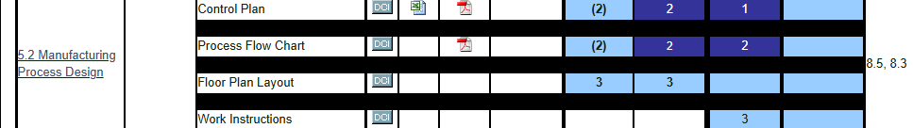
Version 8 changes
■ 5.0 Manufacturing Process Development
5.2 Manufacturing Design Process
Control Plan
Blank Excel Sheet of Safe Launch Control Plan added
Examples of completed Safe Launce Control Plan documents added into Control Plan

Slide 6
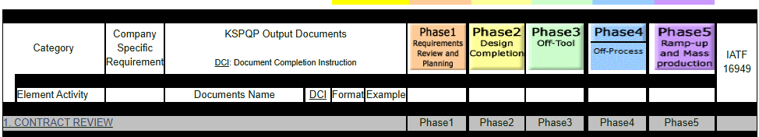
Version 8 Changes
■ 5.0 Manufacturing Process Development
5.6 Activities during Ramp-up
As a new requirement submission Ramp-up Activity Plan documents Safe Launch Control Plan was added.
2 Document completed by supplier and submitted to Kasai UK.

Slide 7


