Slide 1

KSPQP Version 7
February, 2024

Slide 2
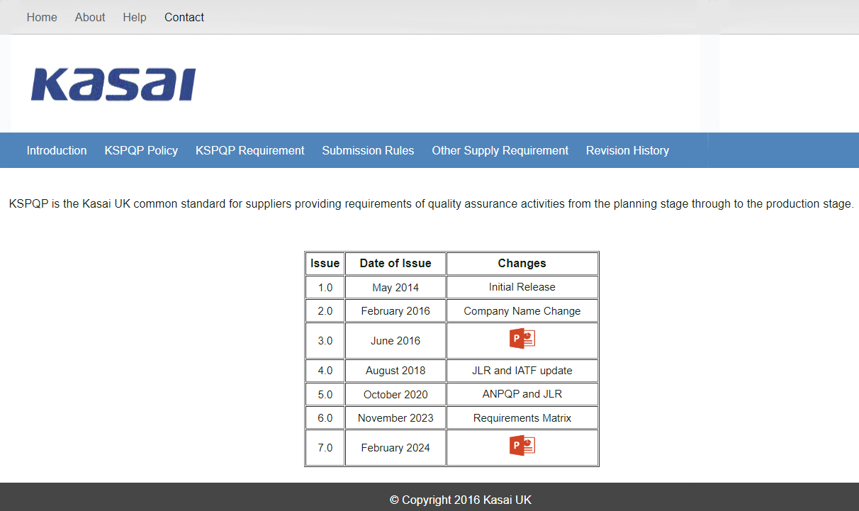
Version 7 changes
Click Icon to access change information

Slide 3
Image to show Rev page / History page
Revision History link added

Slide 4
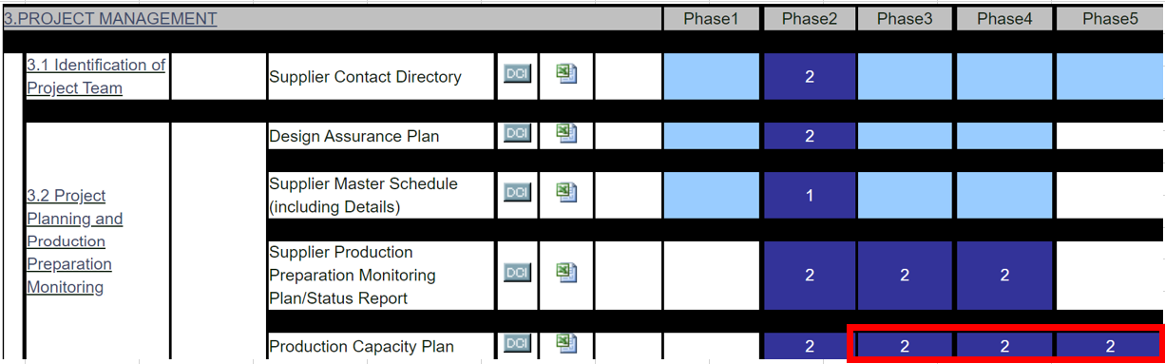
Version 7 changes
■ 3. POJECT MANAGEMENT
3.2 Project Planning and Production Preparation Monitoring
As a new requirement submission of PCP document(s) was added for Phase 3, Phase 4 and Phase 5.

Slide 5
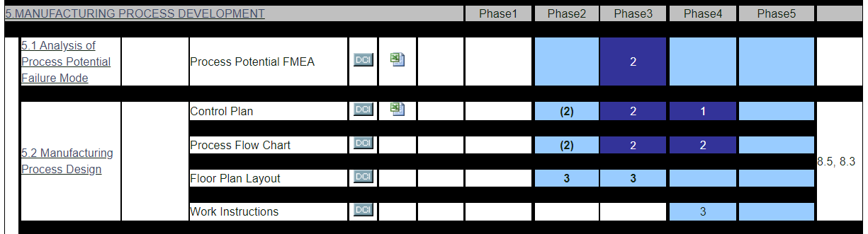

Version 7 changes
■ 5.0 MANUFACTURING PROCESS DEVELOPMENT
5.1 & 5.2 Manufacturing Process design.
Examples of completed documents added into PFMEA
Control Plan
Process Flow Chart

Slide 6

Version 7 changes
■ 5.0 MANUFACTURING PROCESS DEVELOPMENT
5.4 Process Capability Study and Improvement
Blank Excel Sheet & Example of a completed PCSR added

Slide 7
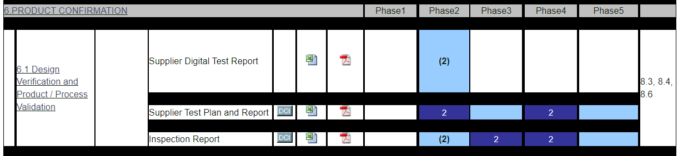
Version 7 changes
■ 6.0 PRODUCTION CONFIRMATION
6.1 Design Verification and Product / Process Validation
Error within the formula on the Inspection Report Excel sheet corrected

Slide 8
Version 7 changes
■ 6.0 PRODUCTION CONFIRMATION
6.1 Design Verification and Product / Process Validation
Error within the formula on the Inspection Report Excel sheet corrected

Slide 9
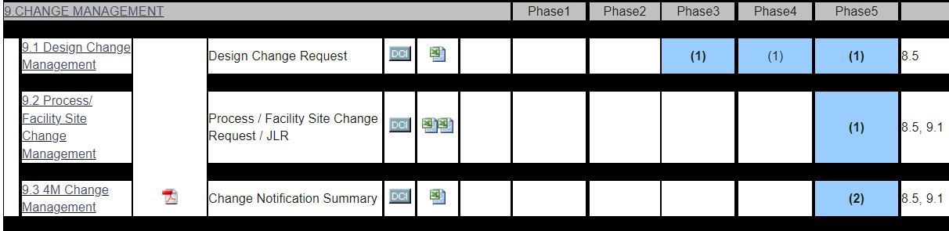
Version 7 changes
■ 9.0 CHANGE MANAGEMENT
9.2 Process / Facility Site Change Management
All References to JLR removed from the SREA

Slide 10


