Slide 1

KSPQP Version 3
June, 2016

Slide 2
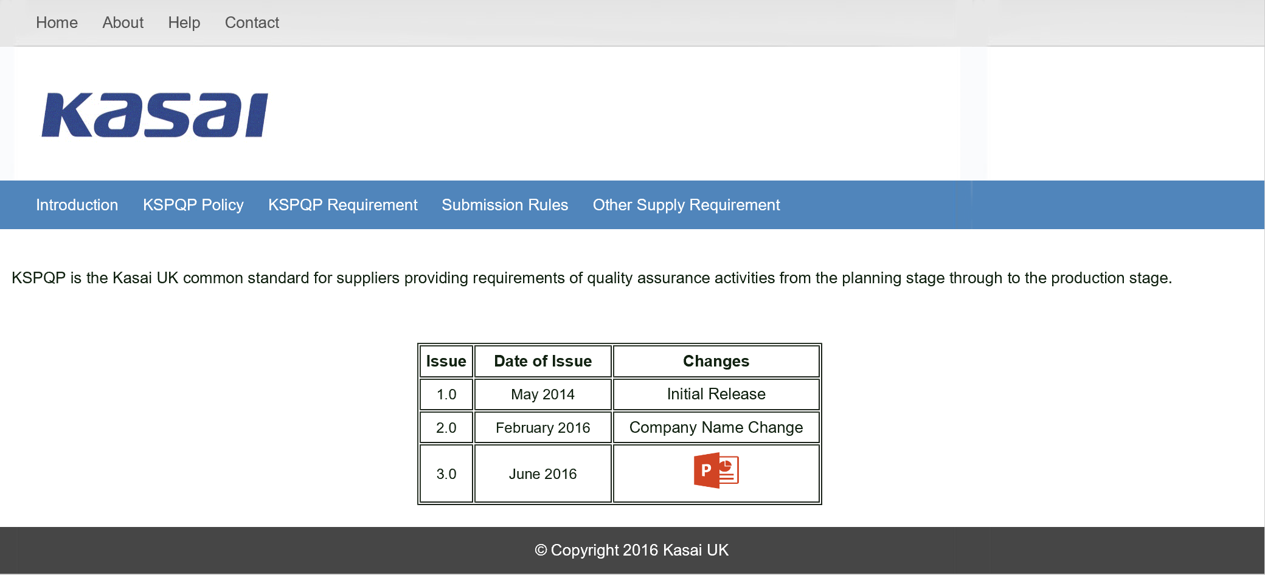
Version 3 changes
Click Icon to access change information

Slide 3
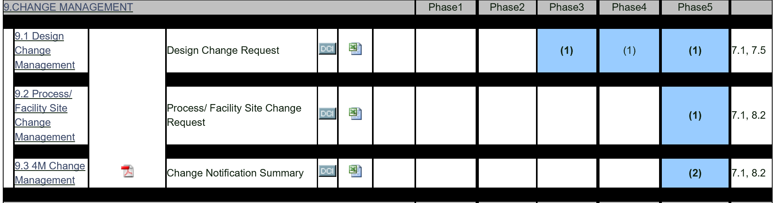
Version 3 changes
■ 9.0 Change Management
9.3 4M Change Management

Slide 4
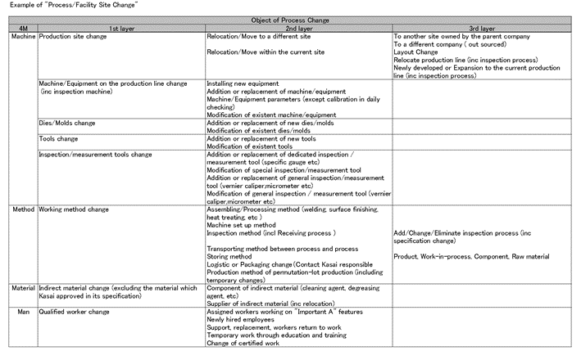
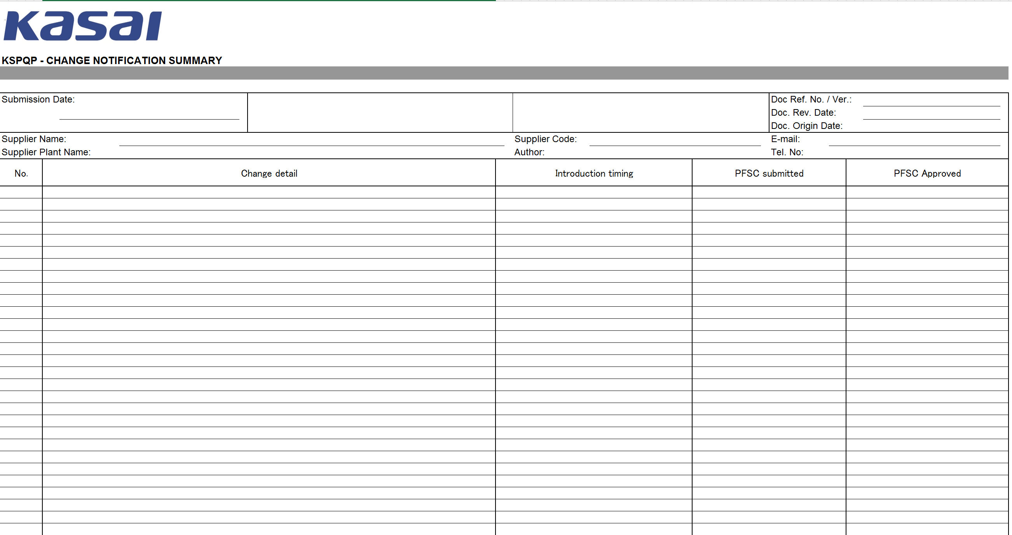
Version 3 changes
■ 9.3 Change Management
Update and submit the 4M change notification summary for every process change. (See example of "Process / Facility Site Change" sheet for examples of typical process changes)

Slide 5
Version 3 changes
■ 9.3 Change Management
Submit documentation on or before 20th of each month.

Slide 6


